Slide 1
Flow-o-Matic ™
Agoston Walter and Alex Shang BME 354 Monday Lab
April 15, 2019

Slide 2


Slide 3
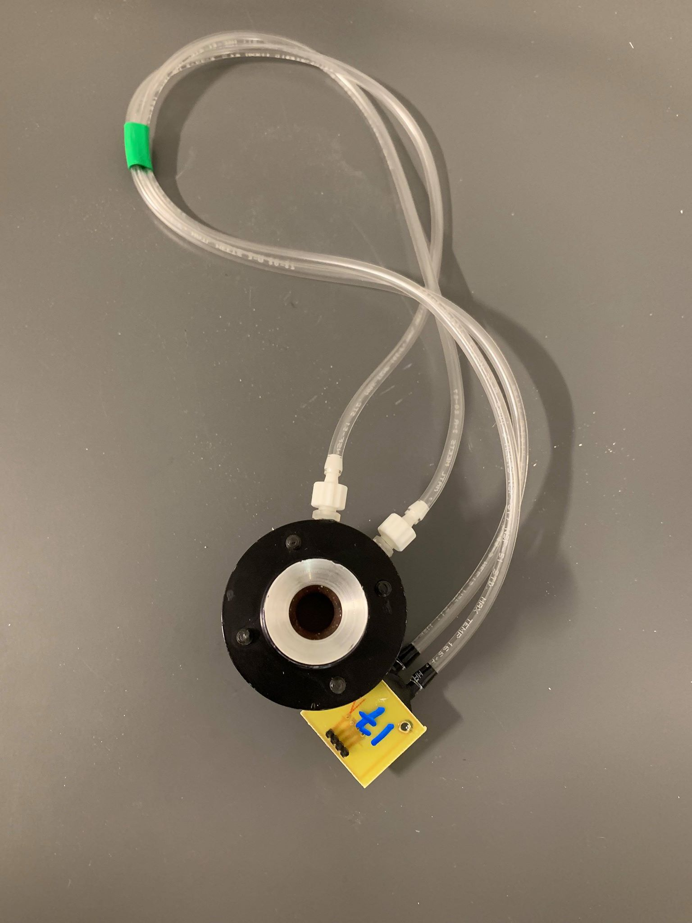
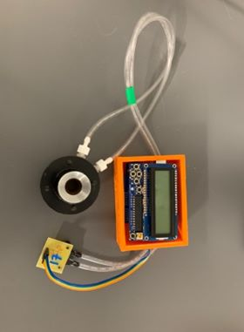
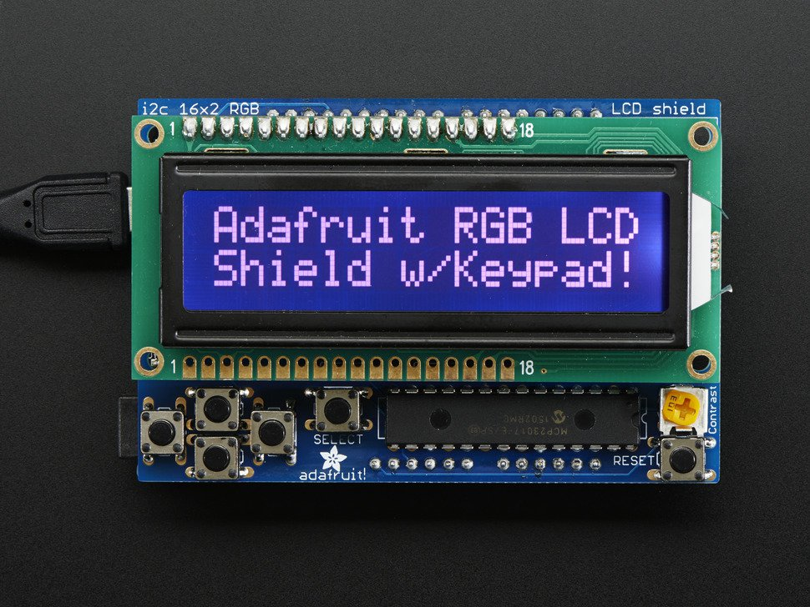
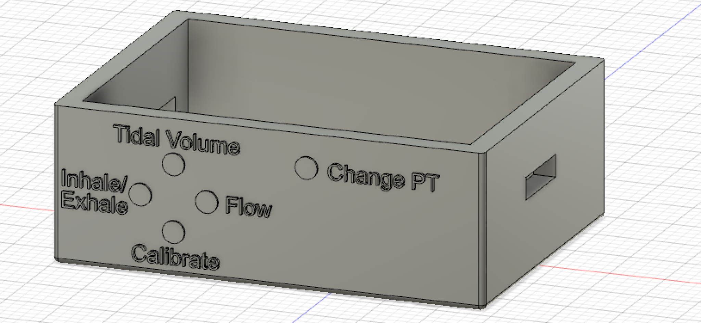
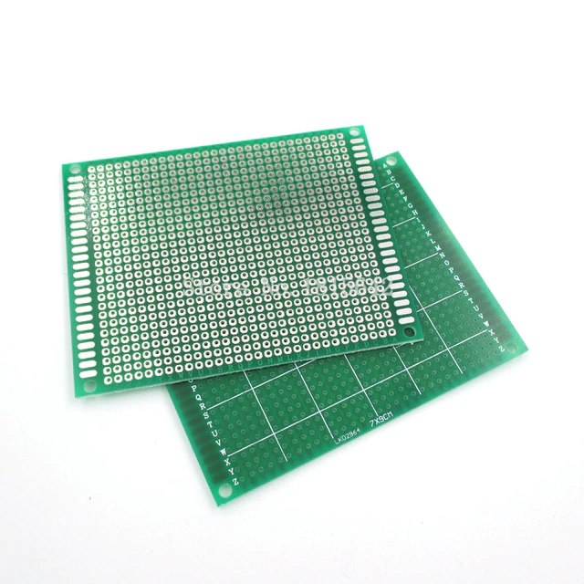
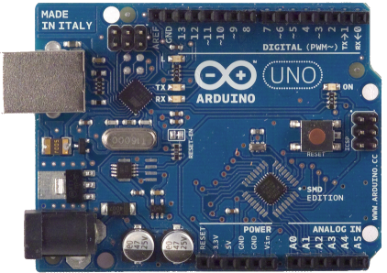
Our Product
+
=

Slide 4
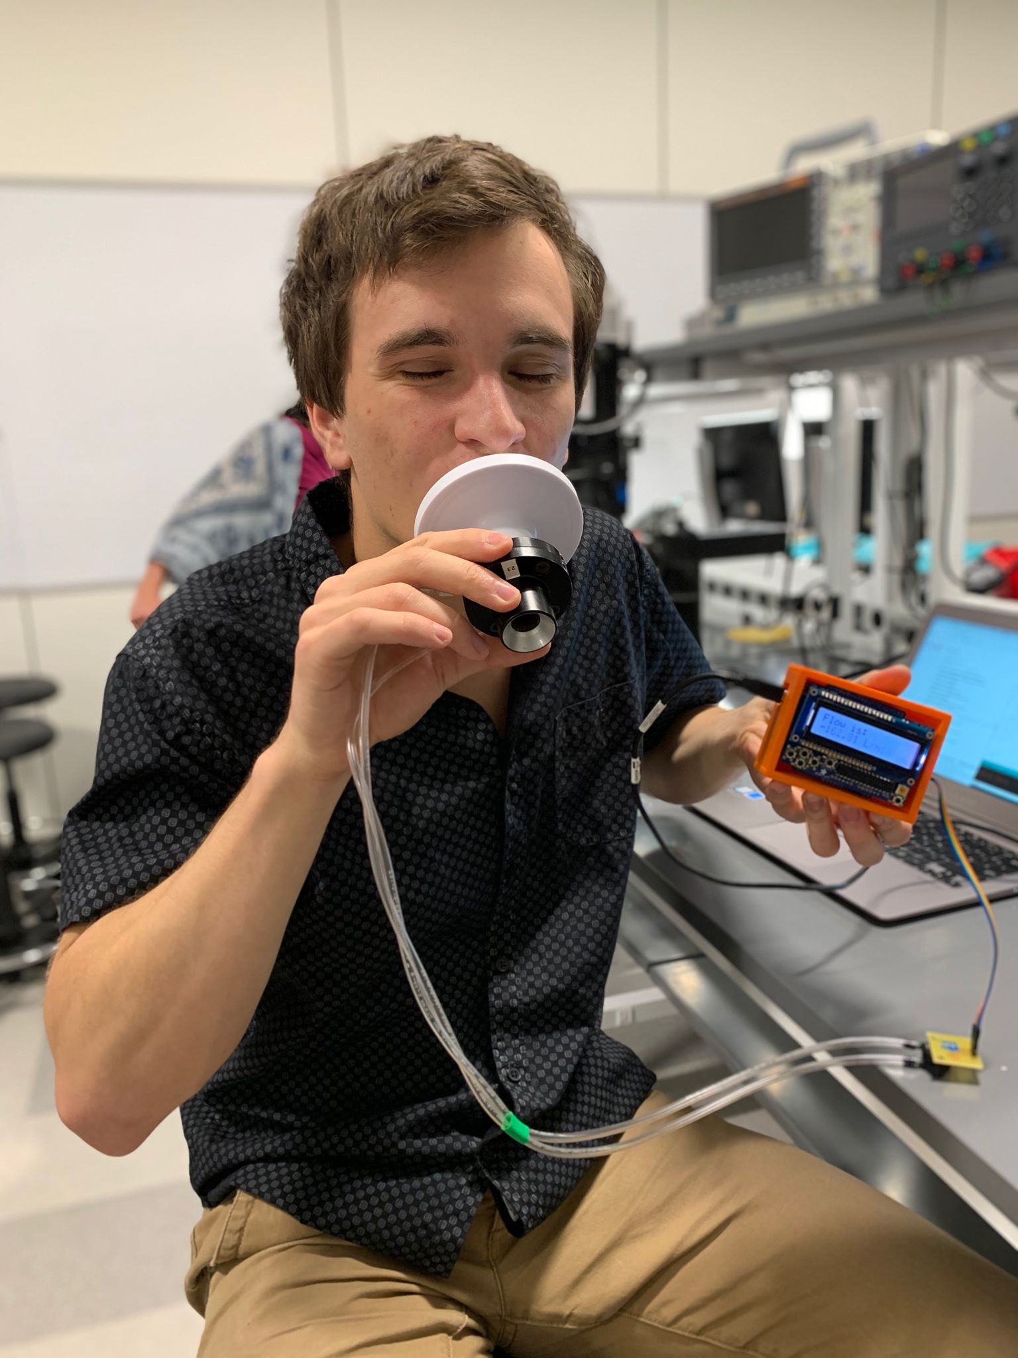
Functionality
Retains patient data even when powered off
Multiple Modes:
Tidal Volume
Inspiratory Capacity
Expiratory Capacity
Flow Meter
Self-Calibration
Intuitive Design
Protection/Portability
Promotional Picture

Slide 5
Block Diagram
Pneumotach
LCD with Buttons
MPX2010DP Sensor
Gain of 3205, difamp
Gain of 10, summing amp
Low Pass Filter
Arduino
Notes:
G = 5 + 80 kΩ/RG, theoretical gain of 3205, gain of 10 in summing amp

Slide 6
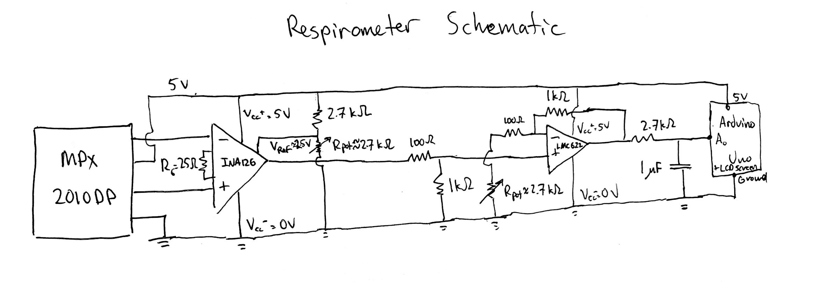

Slide 7
Code Flowchart
Tidal Volume
Select Pneumotech
Up
Select
Expiratory Cap. Meas.
Right
Inspiratory Cap. Meas.
Left
Home Screen
Right
Flow Measurement
Down
Calibration Mode

Slide 8
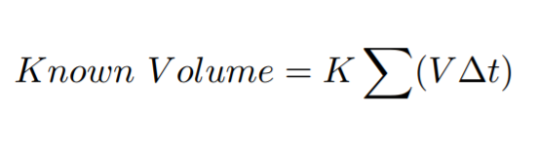
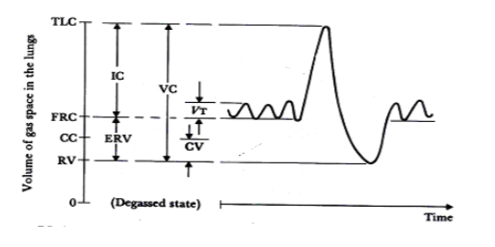
Algorithm Explanation
Global Variables:
Pneumotech selected
Voltage Offset
Sum
Calibration Inhale
Calibration Exhale

Slide 9
Subject Test Data
Exhale Constant | Inhale Constant
5.07 | 7.49
 | Insp. Volume | Exp. Volume | Tidal Volume
Subject 1 | 2.97 L | 4.14 L | 0.86
Subject 2 | 4.21 L | 4.15 L | 0.50 L

Slide 10
Pneumotachometer Test: Clinical Grade v. Homemade
 | Inhale K | Exhale K | Insp. Cap. w/ syringe | Exp. Cap. w/ syringe
Clinical Grade | 7.49 | 5.07 | 2.96 | 3.14
Homemade | 9.39 | 10.59 | 4.16 | 2.81

Slide 11




Challenges
Limited number of buttons
INA126 Op Amp
Choosing Dynamic Range
Editing Soldered PCB

Slide 12
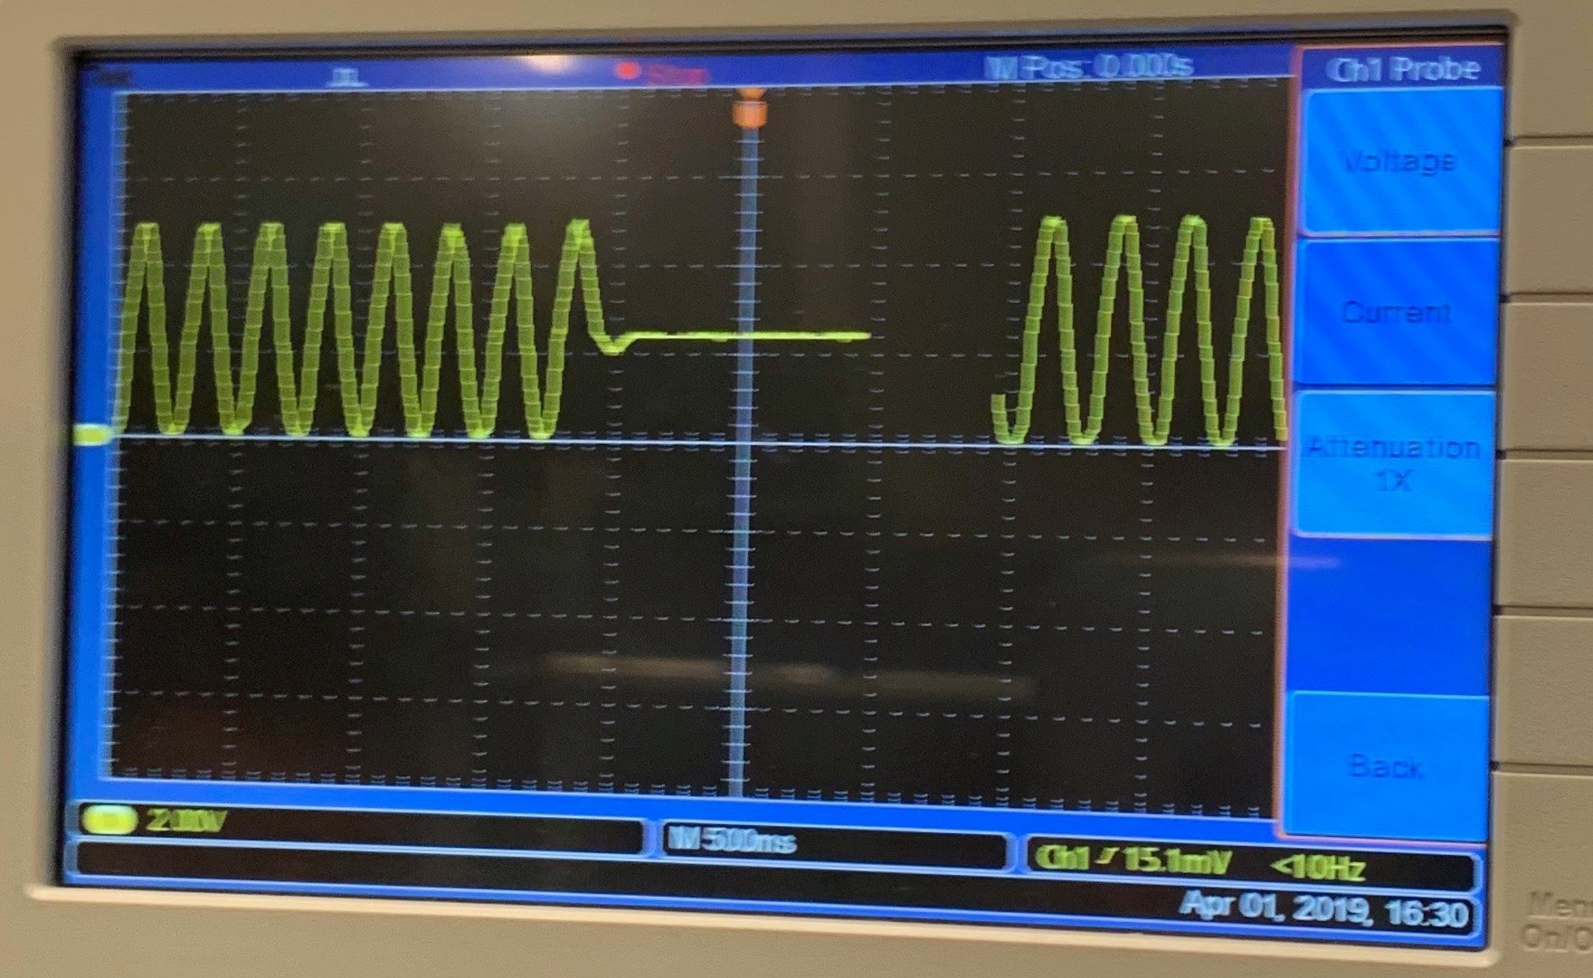
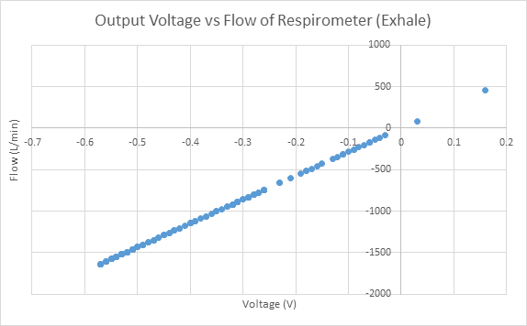
Dynamic Range

Slide 13
Additional Design Features
Flow-o-Matic 2.0™?
Portable Battery Pack
Waterproof Casing
Wireless Capability
Diagnostic Screen
Higher Resolution

Slide 14
Questions?

Slide 15
References
Duke BME 354 Final Project : Design and Build a Spirometer Guidelines
Duke BME 354 Laboratory 8: Arduino Spirometry

